Slide 1
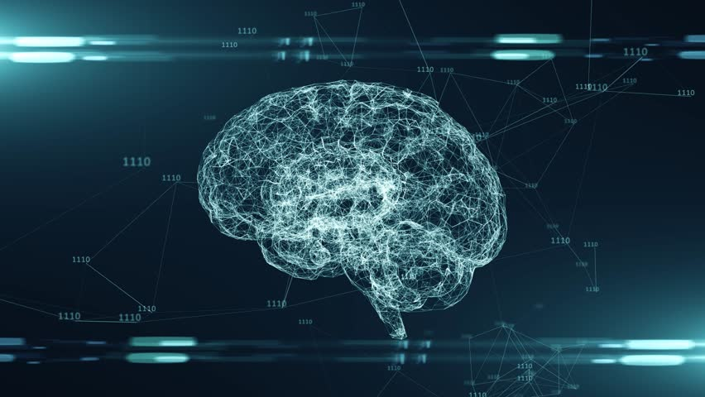
ARTIFICAL INTELLIGENCE
A presentation by khloud
Group A

Slide 2
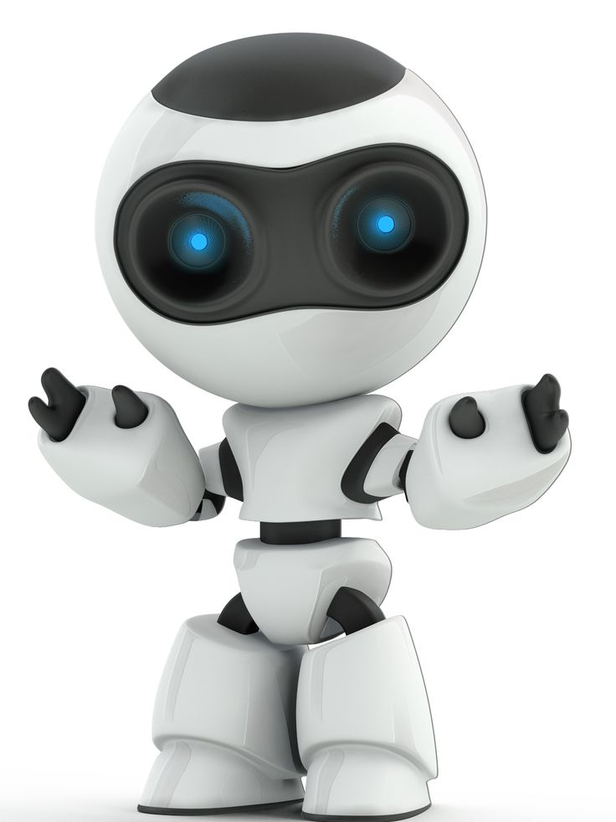
AI, or artificial intelligence, is the ability of machines to learn from data and perform human-like tasks. AI systems learn by training, where they are given a large amount of data and a set of instructions to find patterns and features in the data. AI systems can use different methods and technologies, such as deep learning and natural language processing, to achieve various goals, such as playing chess or driving cars.
It can also independently perform complex tasks that once required human input, such as communicating with customers online or playing chess.
WHAT IS AI?

Slide 3
EXAMPLES
Autonomous vehicles
Navigation apps
used for various situations, but these AI can be are some examples of AI in our daily life.
Chatbots
Facial recognition
E-commerce
Text editors

Slide 4
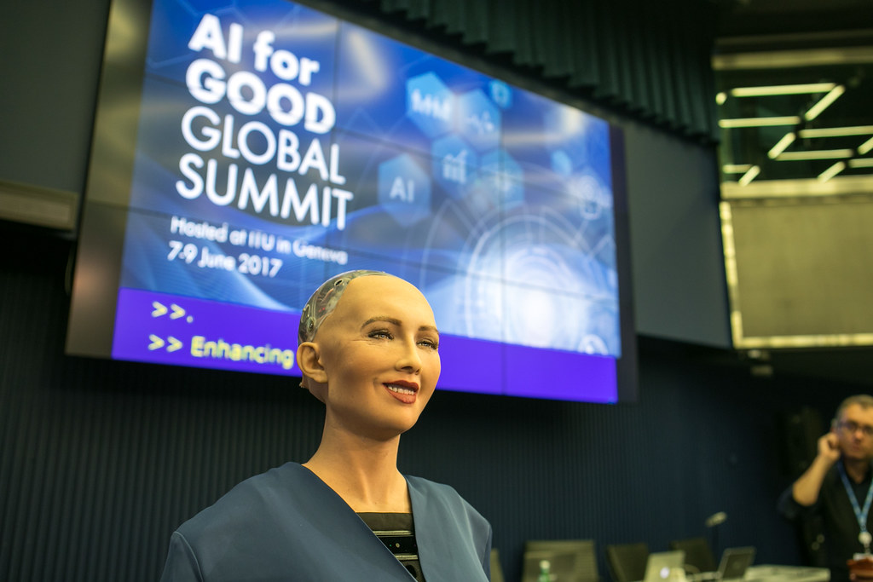
SOFIA THE AI ROBOTS
Sofia is a realistic humanoid robot capable of displaying humanlike expressions and interacting with people. It's designed for research, education, and entertainment, and helps promote public discussion about AI ethics and the future of robotics.

Slide 5
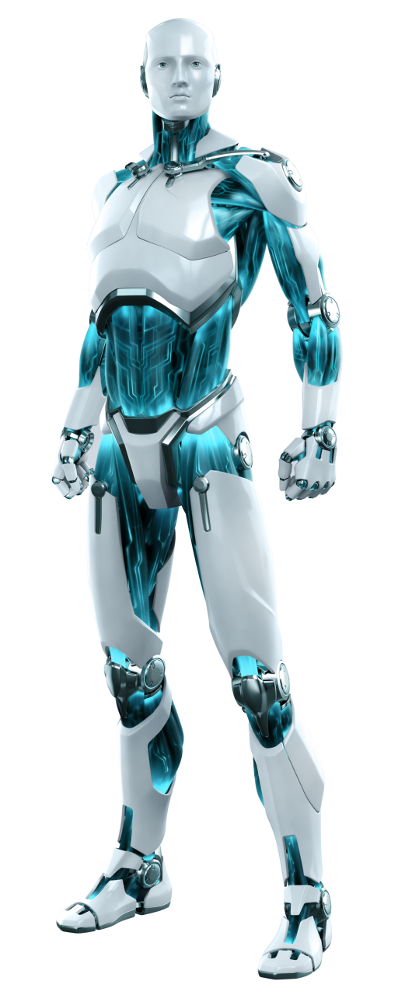
APOLLO THE AI ROBOTS
Apollo is a general-purpose humanoid robot developed by Apptronik, announced in August 2023. Apollo was initially designed to operate in warehouse and manufacturing environments but will eventually expand into other areas like retail, construction, and elderly care.

Slide 6
PROBLEMS CAN AI SOLVE
Cybersecurity → detecting spam
Healthcare → medical records
Research → idea generation, finding data
Transportation → self driving cars
As shown above, AI can solve a LOT of problems.

Slide 7
Advantages of Artificial Intelligence
Advantages
Unbiased Decisions
Reduction in Human Error
New Inventions
Zero Risks
Digital Assistance

Slide 8
Reduction in Human Error
One of the biggest advantages of Artificial Intelligence is that it can significantly reduce errors and increase accuracy.
Another big advantage of AI is that humans can overcome many risks by letting AI robots do them for us.
Whether it be defusing a bomb, going to space, exploring the deepest parts of oceans, machines with metal bodies are resistant in nature and can survive unfriendly atmospheres.
Zero Risks

Slide 9
Digital Assistance
Almost all the big organizations these days use digital assistants to interact with their customers which significantly minimizes the need for human resources.
You can chat with a chatbot and ask them exactly what you need.
AI has helped in coming up with new inventions in almost every domain to solve complex problems.
A recent invention has helped doctors to predict early stages of breast cancer in women using advanced AI-based technologies.
New Inventions

Slide 10
Unbiased Decisions
Human beings are driven by emotions, whether we like it or not.
AI on the other hand, is devoid of emotions and highly practical and rational in its approach.
A huge advantage of Artificial Intelligence is that it doesn't have any biased views, which ensures more accurate decision-making

Slide 11
Disadvantages of Artificial Intelligence
High Costs
AI requires a lot of time and resources to create and maintain, and can be very expensive.
Increase in unemployment
AI can replace human workers in many sectors, leading to job loss and social problems.
Make Humans Lazy
AI can make humans dependent on machines and reduce their mental and physical abilities.
No creativity
A big disadvantage of AI is that it cannot learn to think outside the box.

Slide 12
HOW CAN WE USE AI RESPONSIBLY?
People should use their own creativity, not copy off of AI! AI is just a tool for efficiency!
AI can help do repetitive work for humans, but humans should still be prioritized. Create a culture that utilizes creativity, empathy, and dexterity from humans and AI for increased efficiency. Be aware of financial costs and AI risks.

Slide 13
Thanks for listening!

